Slide 1
ASSESS FORM
APPLICATION

Slide 2
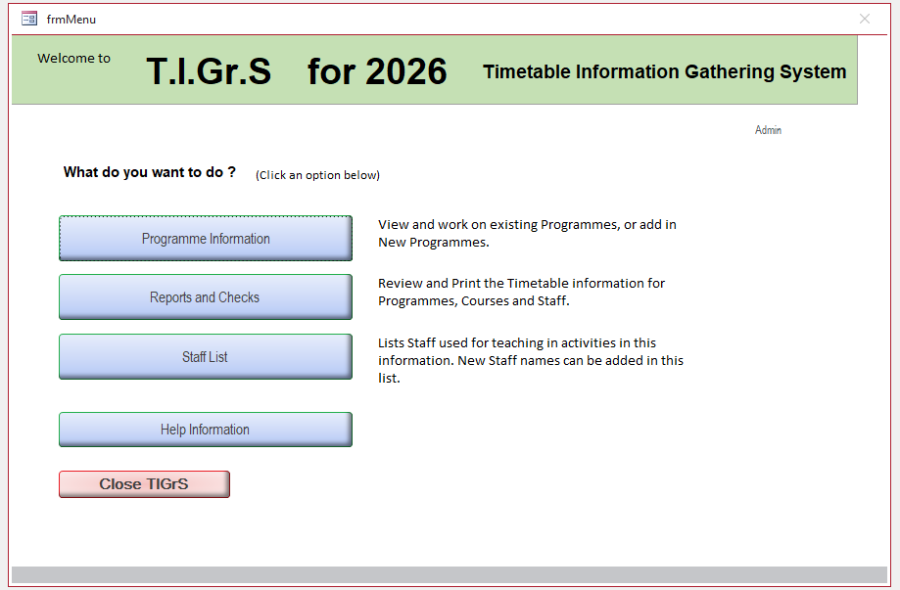
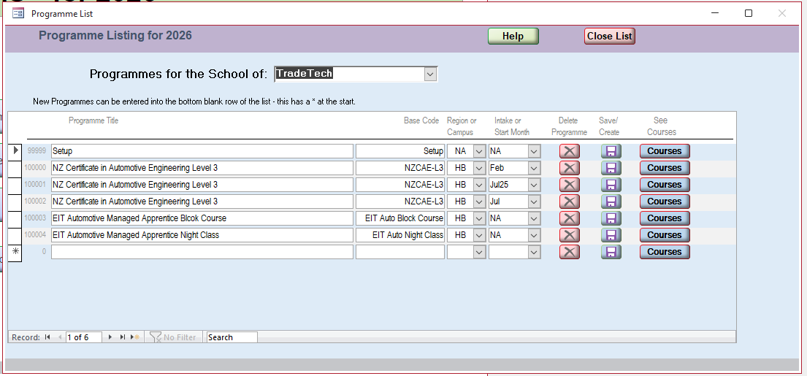
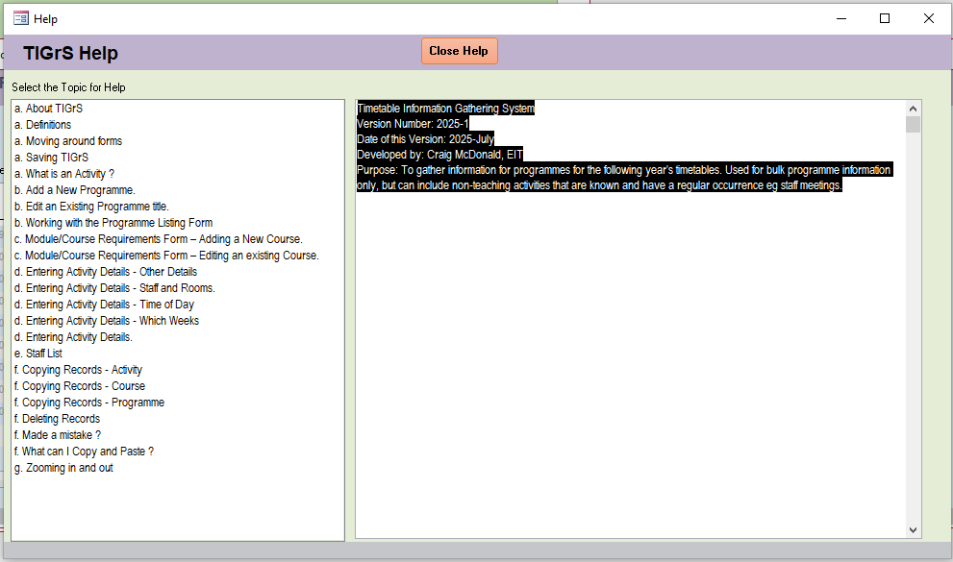
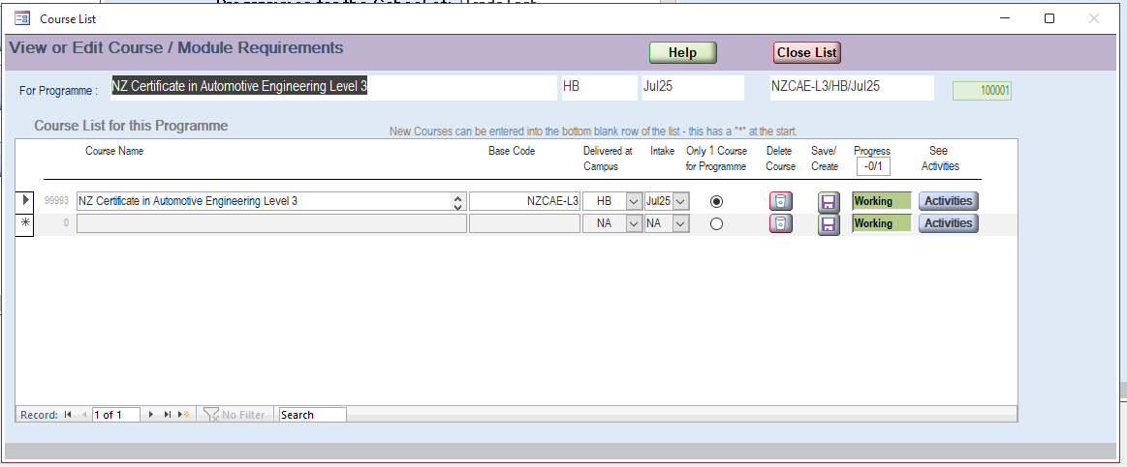
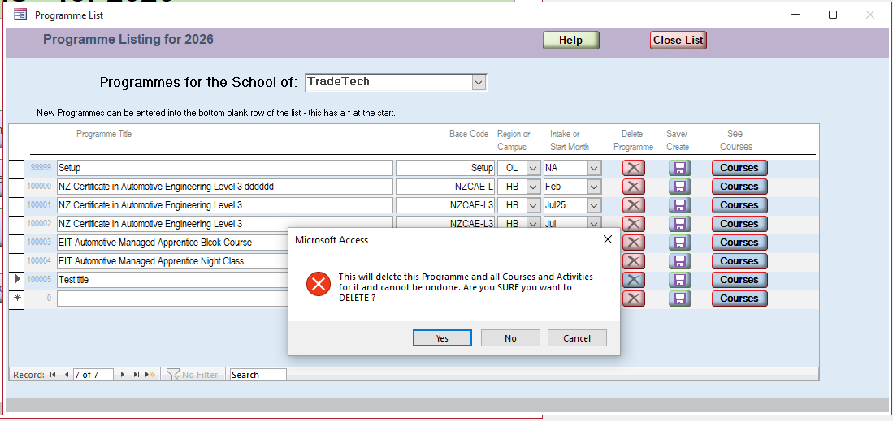
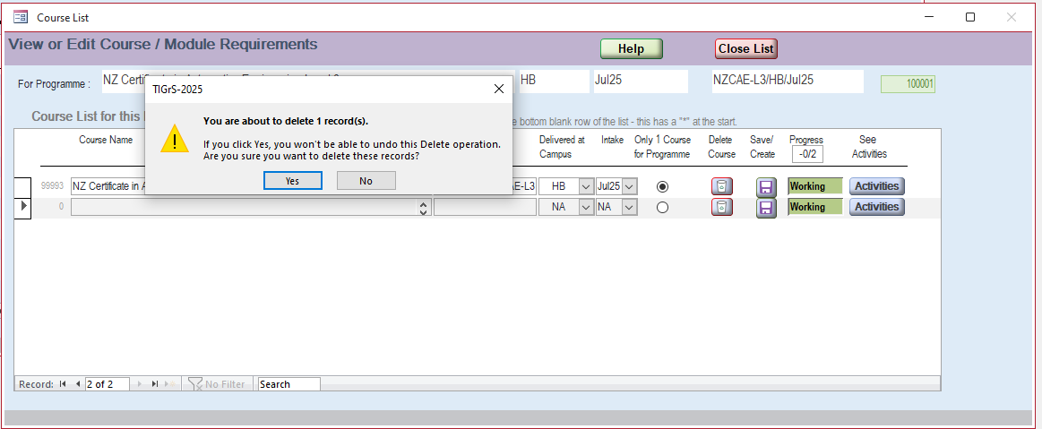
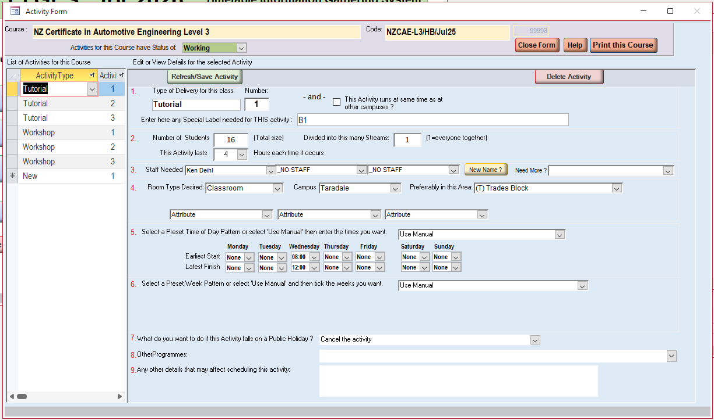
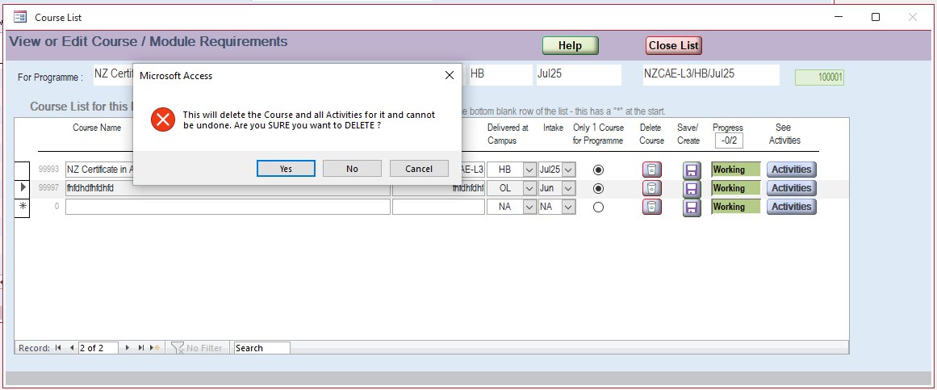
start
Open Assess File
Assess Forms:
Activity Diagrams
Menu Form UI
Questions:
+ “Admin” login on Menu page: is it still needed in excel version? For what purpose?
+ What is “setup” row on Program Form? Do we need to keep it in Excel version?
+ Do we need to keep the checkbox (not radio button) “Only one course for program” on Course List Form?
+ On Activity Form, what purpose of the “refresh” button?
Click “Prog Info” button
(inputs)
Program Form UI
(Functions)
Select School (dropdown menu)
Edit “Prog Title”
Edit “Base Code”
Select Campus (Dropdown)
Select Intake (Dropdown)
See Courses
Search box
Add a new Prog
Delete A Prog
“Close List“ Button
Help Button
Open
Courses Form UI
Highlight the keyword on all fields
“Save” Button
“Confirm” box
Save the updated info and back to main menu
Open Help Interactive Document
(“X” close form is disabled)
Close Help Button
Progress status: Working/ Completed
Edit course Name
Eidt “Base Code”
Select Campus (Dropdown)
Select Intake (Dropdown)
Checkbox (Only one course for Program)
See Activities
Add a new Course
Delete A Course
Search box
“Close List“ Button
Help Button
Open
Activity Form UI
“Save” Button
“Confirm” box
Highlight the keyword on all fields
Save the updated info and back to main menu
Open Help Interactive Document
(“X” close form is disabled)
Close Help Button
List of Activity Types & Number
Eidt “delivery”
Select Room-Type (Dropdown)
Eidt “Student Number”
Add a new Activity
Refresh/Save Activity
Delete Activity
Frint this course
“Close Form“ Button
Help Button
(Focus “red” on compulsory inputs)
Refresh/Save Activity
Save the updated info and back to main menu
(“X” close form is disabled)

Slide 6
EXCEL FORM
APPLICATION

Slide 7
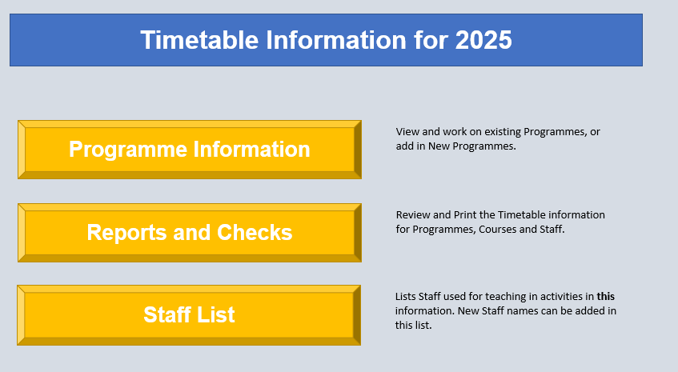
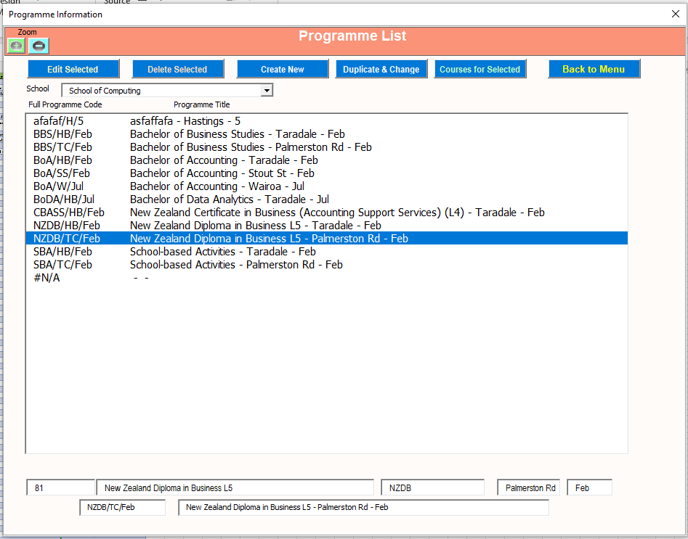
start
Questions:
+ On “Programmes” form, clicking the button “create a new” opens up a new form to add a new program. Good UX. Any other reason behind this separation (instead of creating a new program on the same form)?
Open Excel File
Excel Forms:
Activity Diagrams
Menu Form UI
Click “Prog Info” button
Program Form UI
Delete Selected
Add New
Duplicate and Change
Edit Selected
Courses for Selected
Back to Menu
working
working
working
NOT working
NOT working
Delete the selected program & remove it from Excel sheet
Add a new program to Excel sheet
Add aNnw program with populated data
Update existing program in Excel sheet
Update existing program in Excel sheet

Slide 8
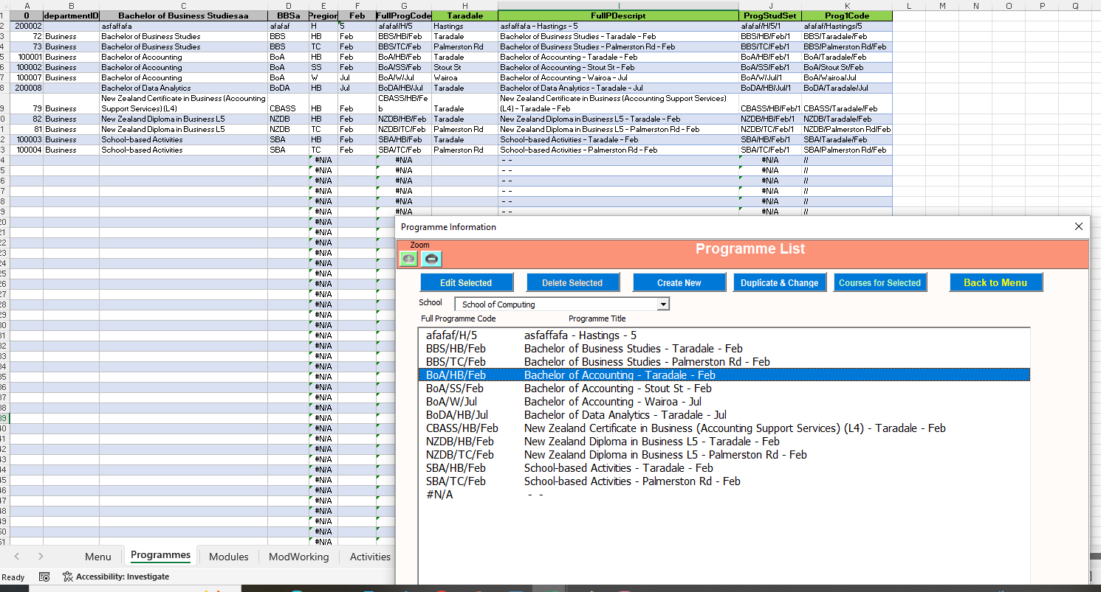
On “programmes” sheet: First column is “0” – why? Is it program code?
On “programmes” sheet : How to generate this number for a newly created program? “200008”
“School” dropdown – not work yet
An error? Should not display N/A
Missing labels: can’t understand the data such as “81”, “Palmerston Rd”
On “programmes” sheet : Last row (292): what is this data?

